Slide 1

BAYMAX
- Refined, accurate & quick search
Challenge: Breast Cancer Survival Detection App
Team Members
Dikshant
Brute Force
presents :

Slide 2
Problem Statement :
A person has X breast cancer & he want to whether he/she will survive breast cancer with given clinical parameters.
Solution : Baymax

Slide 3
What is Baymax?
Baymax is a web application or a platform where it predicts whether or not person will survive breast cancer, according to the symptoms entered by the user.
The Machine learning behind the application goes through the clinical parameters entered by the user and compares the input data with the dataset from Kaggle which is created by the data scientist and gives alive or dead output.

Slide 4
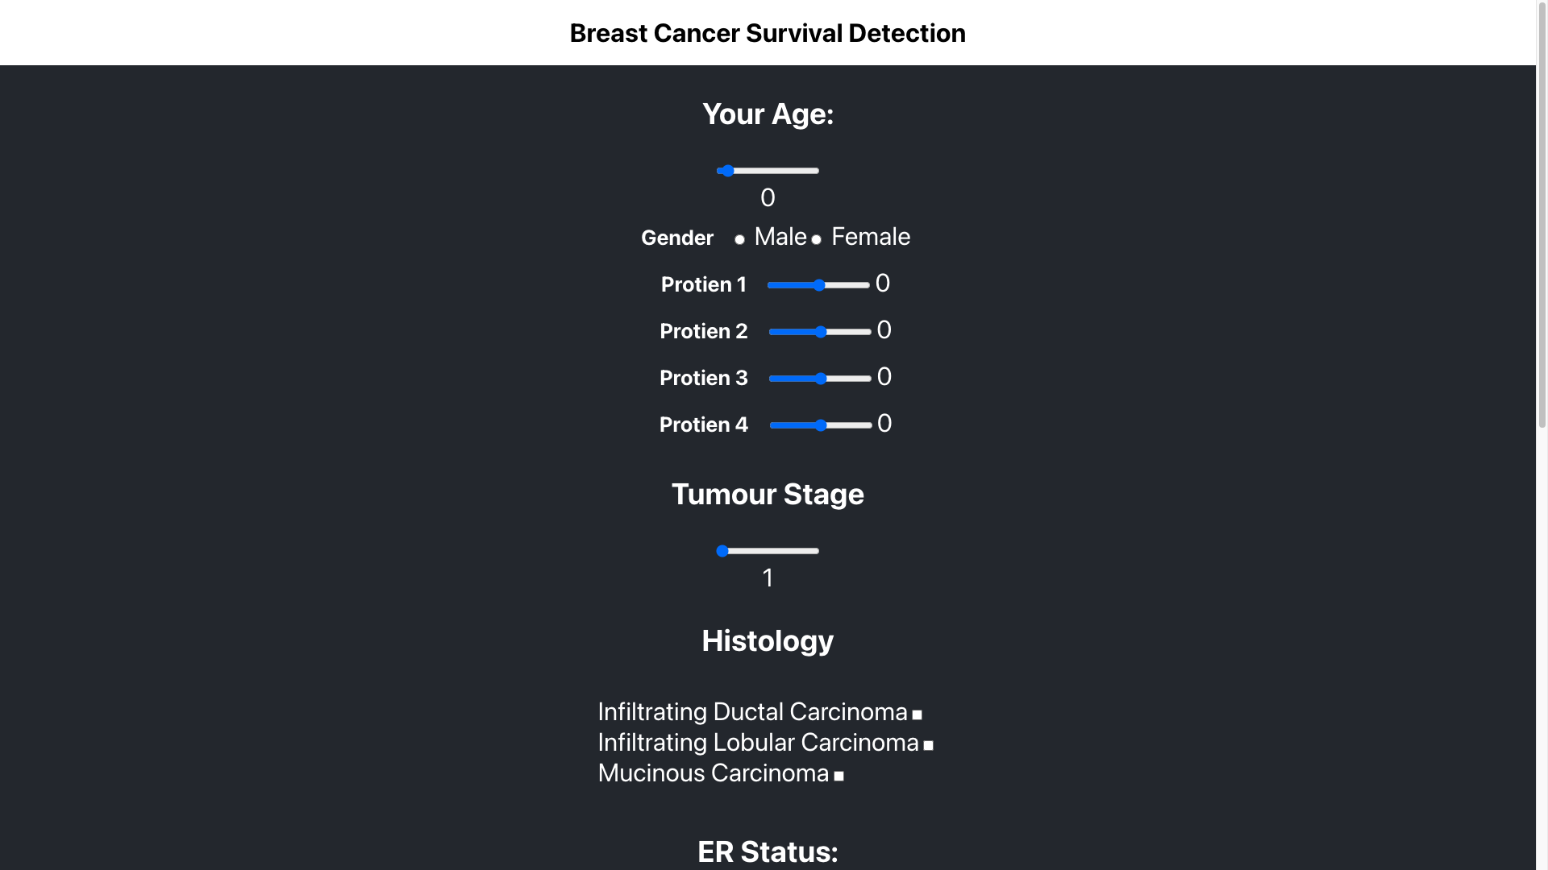
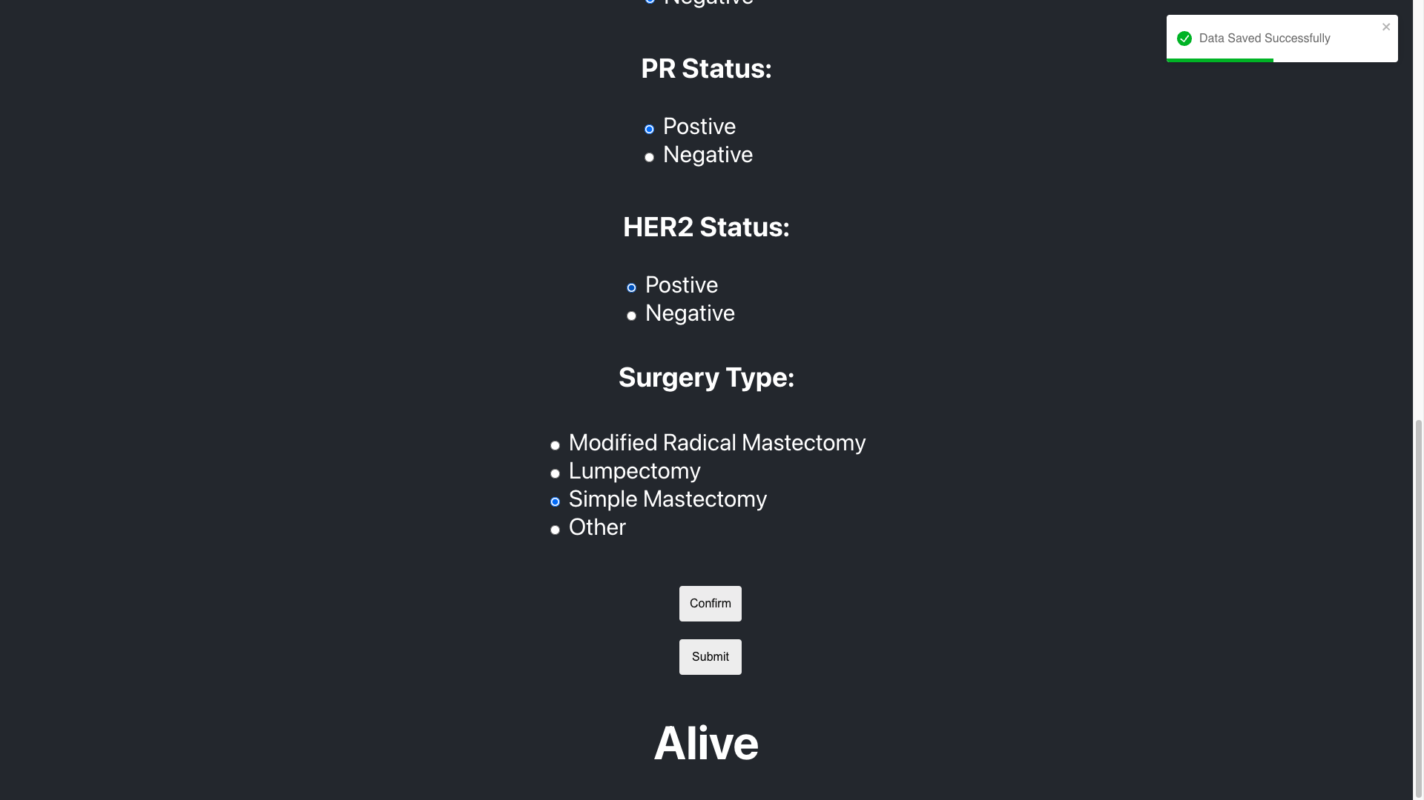
Workflow

Slide 5













Tech Stack

Slide 6
Future Possibilities and scope
Providing specialized doctors in that category of disease.
Virtual support of doctors 24/7.
We can improve our models by increasing the training dataset.
We can expand our web app to Android.

